Slide 1
Introduction to Machine Learning
Overview – Design of a Learning System
Types of Machine Learning
Supervised Learning and Unsupervised Learning
Mathematical Foundations of Machine Learning
Applications of Machine Learning , Machine Learning Foundations

Slide 2
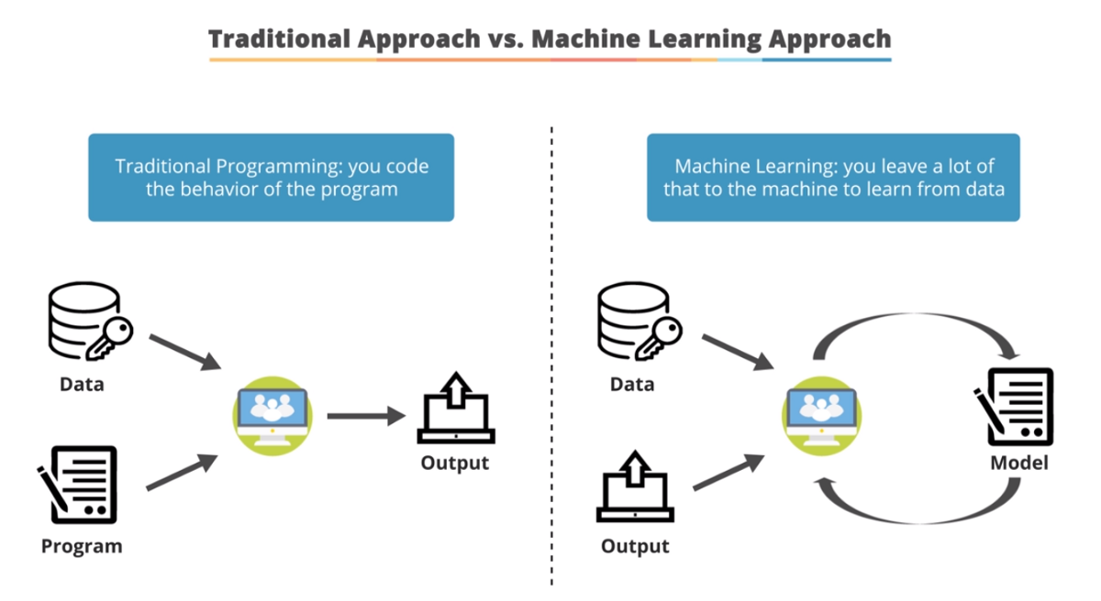
Traditional Programming Vs Machine Learning
Traditional Programming refers to any manually created program that uses input data and runs on a computer to produce the output.
In Machine Learning, also known as augmented analytics, the input data and output are fed to an algorithm to create a program. This yields powerful insights that can be used to predict future outcomes.

Slide 3
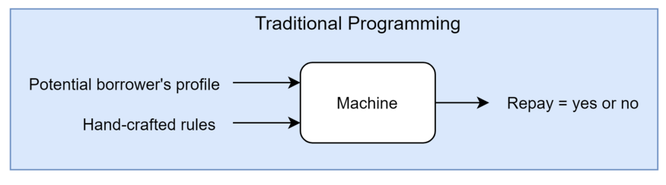
Traditional Programming Vs Machine Learning Example
Credit Risk Estimation: Our goal is to automatically evaluate the risk that a potential borrower will pay a loan or not.
Traditional Approach
Eg. If income > 150k AND saving > 200k, then Repay = Yes
Eg. If income < 150k AND saving < 200k, then Repay = No

Slide 4
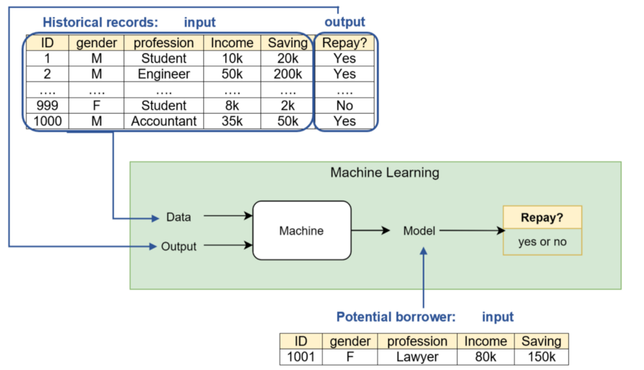
Traditional Programming Vs Machine Learning Example
Credit Risk Estimation: Our goal is to automatically evaluate the risk that a potential borrower will pay a loan or not.
ML approach

Slide 5
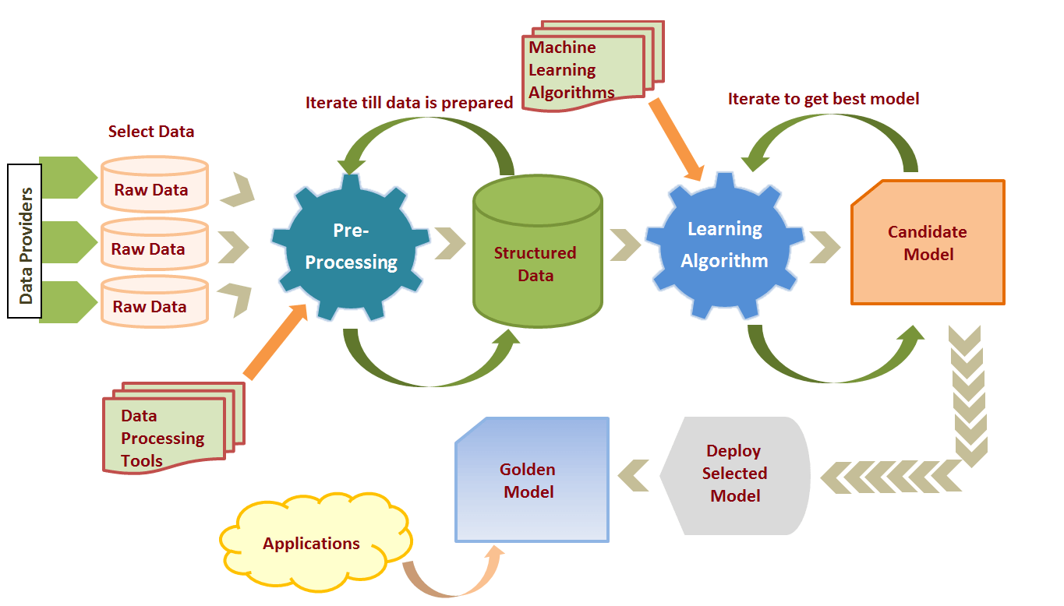
Machine Learning Process

Slide 6
Machine Learning Process
1.Data Preparation and Data Pre-processing
Data preprocessing is a process of preparing the raw data and making it suitable for a machine learning model.
It includes Data Integration , Data transformation , Data Cleaning and data reduction
2. Model selection
There are many models that researchers and data scientists have created over the years.
Some are very well suited for image data, others for sequences (like text, or music), some for numerical data, others for text-based data.
Model selection in machine learning refers to the process of choosing the best model from a set of candidate models for a specific task or problem

Slide 7
3. Training
In this phase we use data sets to incrementally improve model’s ability.
Training data set
Is the data set on which model is trained
Train data set is data set from which the model has learned the experiences.
Training sets are used to fit and tune models.
Test data set
Test data is the data that is used to check if the model has learned good enough from the experiences it got in the train data set.
Test sets are “unseen” data to evaluate your models.

Slide 8
4. Evaluation
Evaluation allows us to test our model against data that has never been used for training.
5. Model Deployment
Deployment of an ML-model simply means the integration of the finalized model into a production environment and getting results to make business decisions.

Slide 9
Revise
1. Explain steps of machine learning process
2. Define the terms training data and testing data
3. Compare traditional programming and machine learning

Slide 10
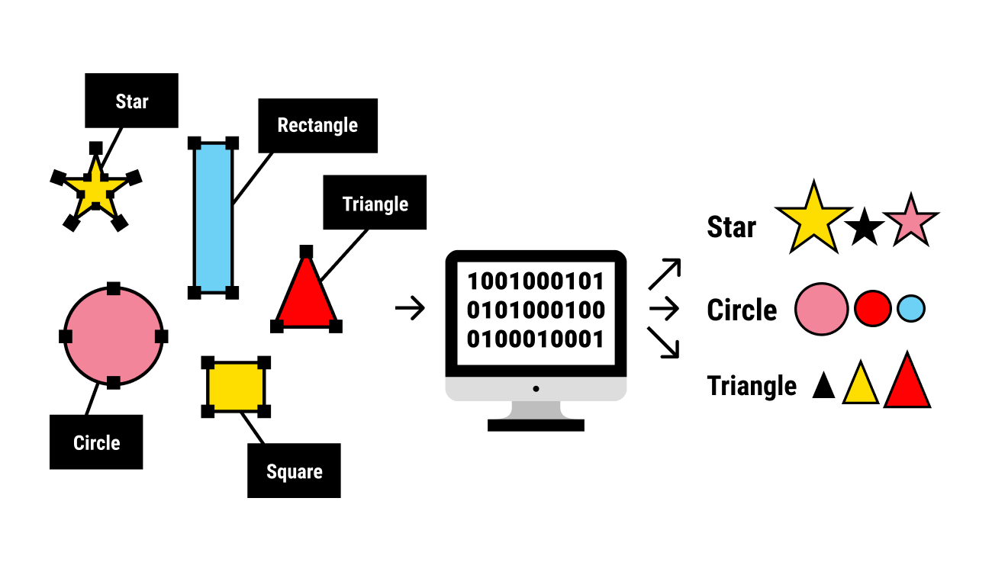
Terms used in types of machine learning
1.Labeled Data
Data consisting of a set of training examples, where each example is a pair consisting of an input and a desired output value
Ex.
1.
Data set shown in the image is labeled
data set. Every image is labeled by its shape
Input Output

Slide 11
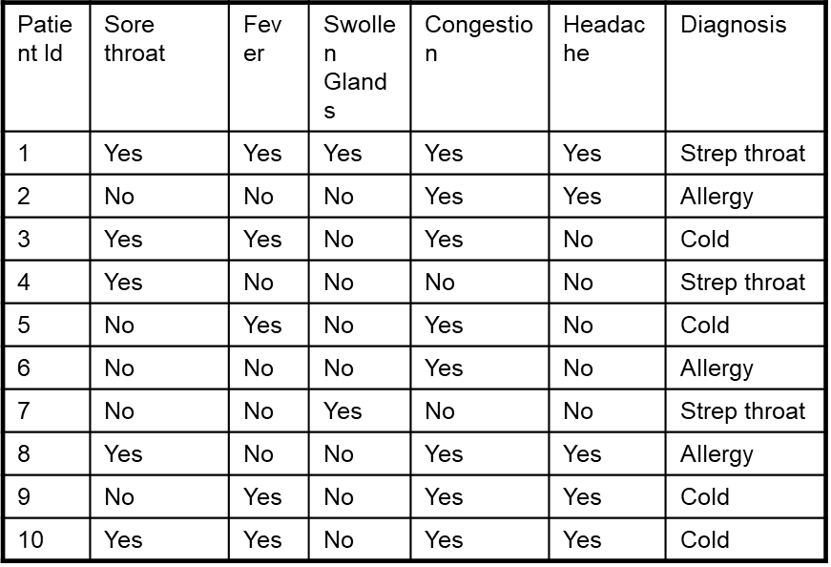
Ex.
2.
Data set shown in the image is labeled
data set. Every record is labeled with
the value for diagnosis.
Labels(output) here are , Strep Throat, allergy or cold
Output
Input

Slide 12
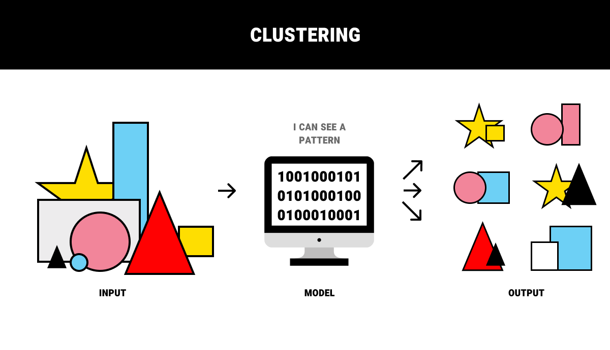
2.Unabled Data
Unlabeled data doesn’t have any meaningful tags or labels .
Ex.
1.
Data set shown in the image is unlabeled data set. shape.

Slide 13
Ex.
2.
Data set shown in the image is Unlabeled
data set.
Input

Slide 14
Types of machine Learning
Supervised learning
Supervised learning is the types of machine learning In which machine learning algorithms are feed with the well labeled data.ie. Input and its associated output.
From the labeled data algorithms should be able to learn the patterns
Supervised learning algorithms try to model relationships and dependencies between the target prediction output and the input features
And then we can predict the output values for new data based on those relationships which it learned from the previous data sets.
Are the family of algorithms that which are mainly used in classification and prediction

Slide 15
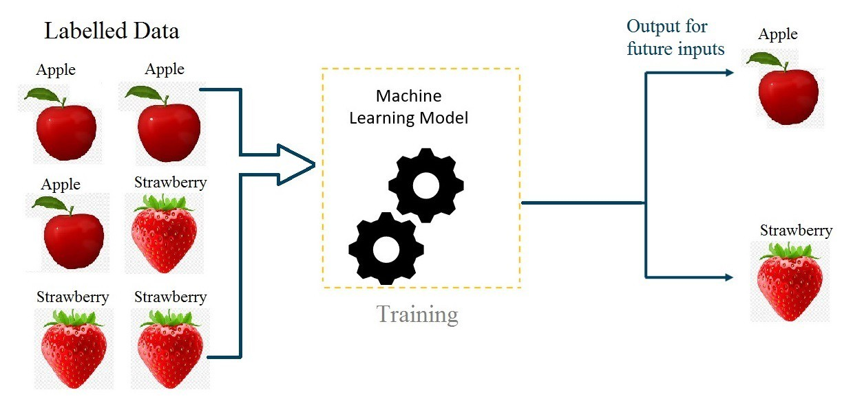
Supervised learning

Slide 16
Types of machine Learning
2. Unsupervised learning
Unsupervised learning is a category of machine learning in which we only have the input data to feed to the machine learning algorithm but no corresponding output
Algorithm learns the patterns based on the similarity between input data instances .
Are the family of algorithms that which are mainly used pattern detection and descriptive modeling
These algorithms try to use techniques on the input data to mine for rules, detect patterns, and summarize and group the data points which help in deriving meaningful insights and describe the data better to the users.

Slide 17
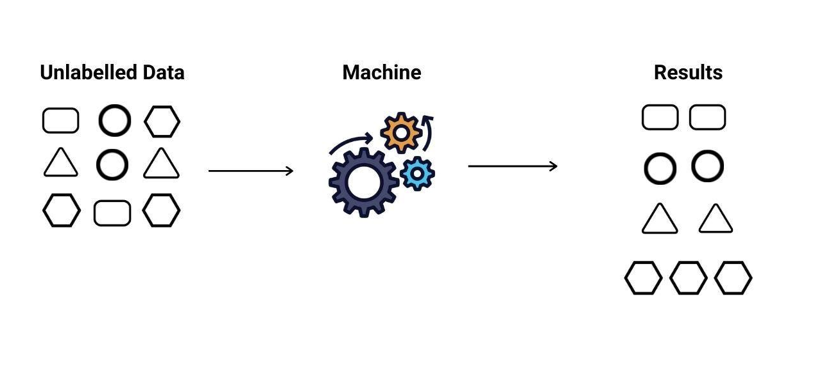
Unsupervised learning

Slide 18
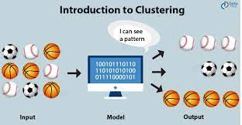
Unsupervised learning

Slide 19
Revise
Explain the terms Labeled data and unlabeled data
Explain supervised learning
Explain unsupervised learning

